Slide 1
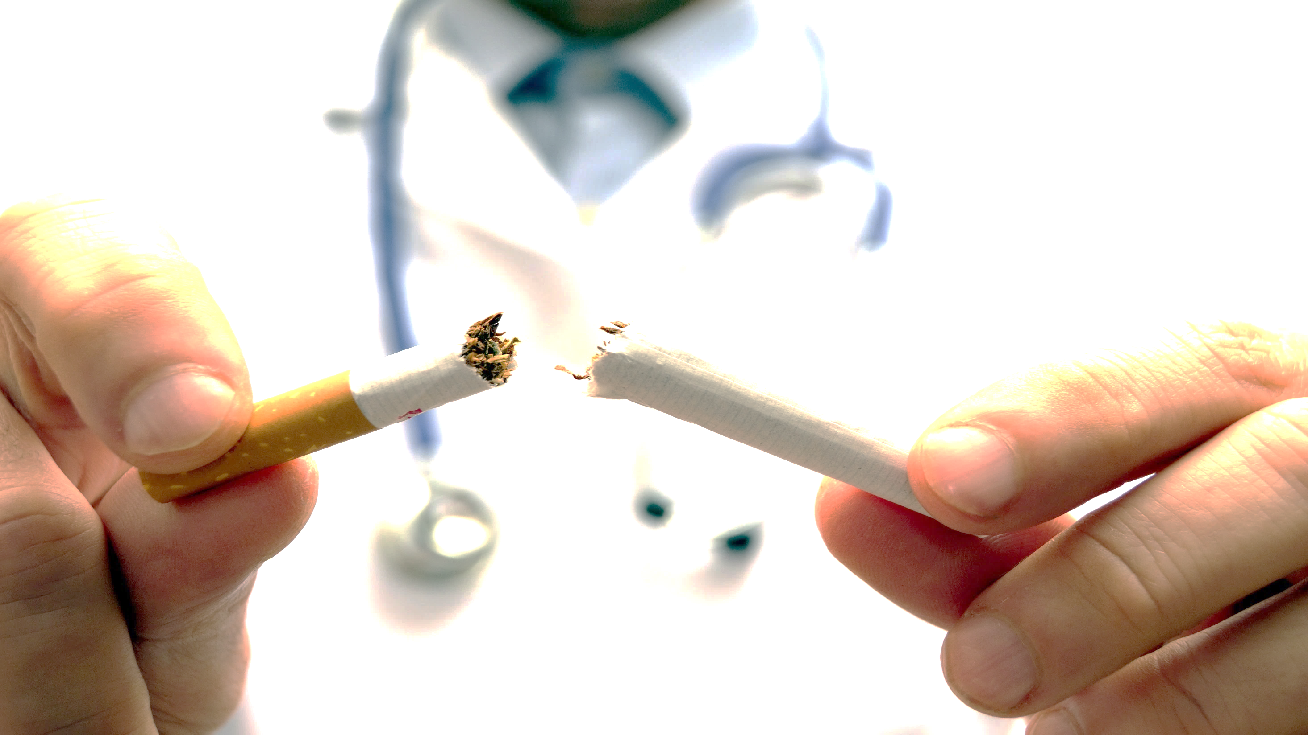
Quit Smoking. Cherish Your Life! 遠離煙草。 珍惜生命！

Slide 2
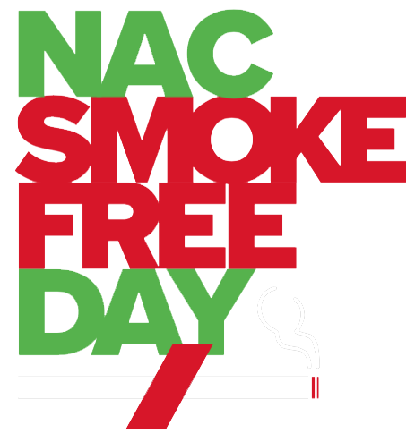
North American Chinatown Smoke Free Day 北美華埠戒煙日

Slide 3
Partners 合作機構

Slide 4
Speakers 特邀演講者
蔡亦聰醫生 Dr. Steven Cai
Clinical Assistant Professor Mount Sinai
伍慧明 Wai Ming (Pam) Ng
戒菸輔導員
王嘉廉社區醫療中心
紀承佑 Chen Yo Chi
戒煙顧問
亞洲人平等會

Slide 5
健康生活由此起
蔡亦聰醫生
美洲中華醫學會

Slide 6
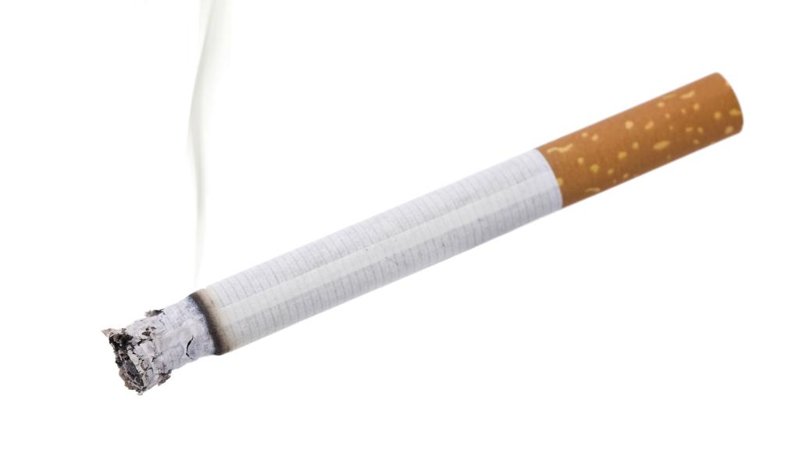
Did You Know? 你知道嗎？
Cigarette smoking causes about 1 of every 5 deaths in the U.S. every year. It causes nearly half a million premature deaths annually!
* However, smoking is the #1 preventable cause of death!
每年在美國, 1/5 的死亡人仕是由吸煙引起的.
每年導致近50萬人提早死亡！
* 然而, 吸煙是排名第一的可預防死因！
Source: U.S. Department of Health & Human Services

Slide 7
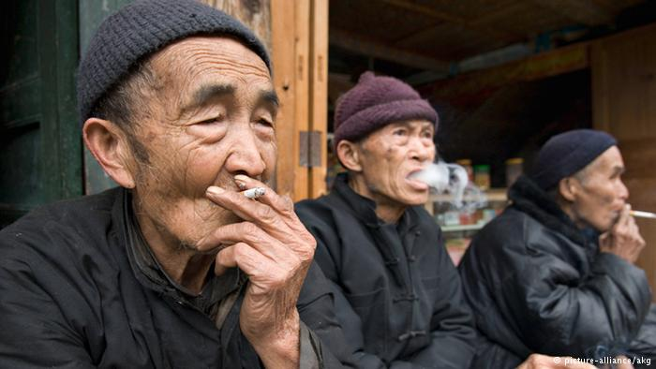
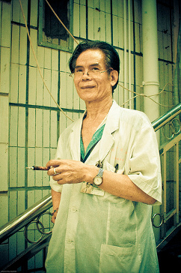
More than one third of the world’s smokers are Chinese.¹ 世界上三分之一的吸煙者是中國人。
There are more than 300 million Chinese smokers.² 超過3億中國人是吸煙者。
68% of Chinese men in China are smokers.³ 中國 68％ 男性是吸煙者。
A disproportionate number of male Chinese physicians in China are smokers.⁴ 在中國，大量的男性醫生都是吸煙者。
Source: Parascandola et al. Tobacco and the lung cancer epidemic in China. Transl Lung Cancer Res. 2019;8(Suppl 1):S21-S30¹, World Health Organization², Chen et al. 2016 Contrasting male and female trends in tobacco-attributed mortality in China: Evidence from successive nationwide prospective cohort studies. The Lancet. 386. 1447-1456.³, Xin, Dingding (2009-12-11). "Smoke-free list extends to healthcare facilities". China Daily⁴
Notes:
1. Parascandola M, Xiao L. Tobacco and the lung cancer epidemic in China. Transl Lung Cancer Res. 2019;8(Suppl 1):S21-S30. doi:10.21037/tlcr.2019.03.12
2. There are more than 300 million smokers in China, nearly one-third of the world's total. More than half of adult men are current tobacco smokers. About one in every three cigarettes smoked in the world is smoked in China. In addition, over 700 million non-smokers in China, including about 180 million children, are exposed to second-hand smoke (SHS) at least once a day in a typical week. Exposure to SHS causes 100,000 deaths annually.
Source: https://www.who.int/china/health-topics/tobacco
3. Chen, Zhengming & Peto, Richard & Zhou, Maigeng & Iona, Andri & Smith, Margaret & Yang, Ling & Guo, Yu & Chen, Yiping & Bian, Zheng & Lancaster, Garry & Sherliker, Paul & Pang, Shutao & Wang, Hao & Su, Hua & Wu, Ming & Wu, Xianping & Chen, Junshi & Collins, Rory & Li, Liming. (2015). Contrasting male and female trends in tobacco-attributed mortality in China: Evidence from successive nationwide prospective cohort studies. The Lancet. 386. 1447-1456. 10.1016/S0140-6736(15)00340-2.
4. Xin, Dingding (2009-12-11). "Smoke-free list extends to healthcare facilities". China Daily.

Slide 8
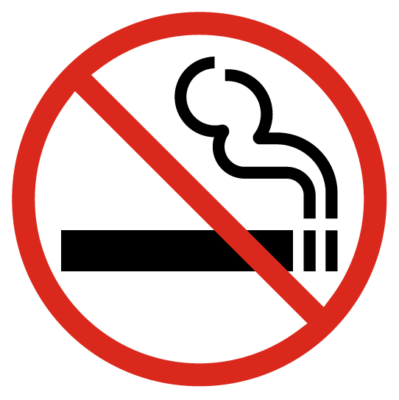
1-in-3 young Chinese men will die from smoking!
每 3 名年輕中國男性中會有 1 人因吸煙而死亡！
Source: Koplan & Eriksen Smoking cessation for Chinese men and prevention for women. The Lancet. 2015;386(10002):1422-1423.
Notes:
Koplan J, Eriksen M. Smoking cessation for Chinese men and prevention for women. The Lancet. 2015;386(10002):1422-1423. doi:10.1016/s0140-6736(15)00416-x

Slide 9
Cigarette smoking is the number one risk factor for lung cancer. In the US, 80-90% of lung cancers are linked to cigarette smoking.
吸煙是導致肺癌的首要因素。在美國，80%-90% 的肺癌患者都有吸煙的習慣。
Source: Centers for Disease Control and Prevention

Slide 10
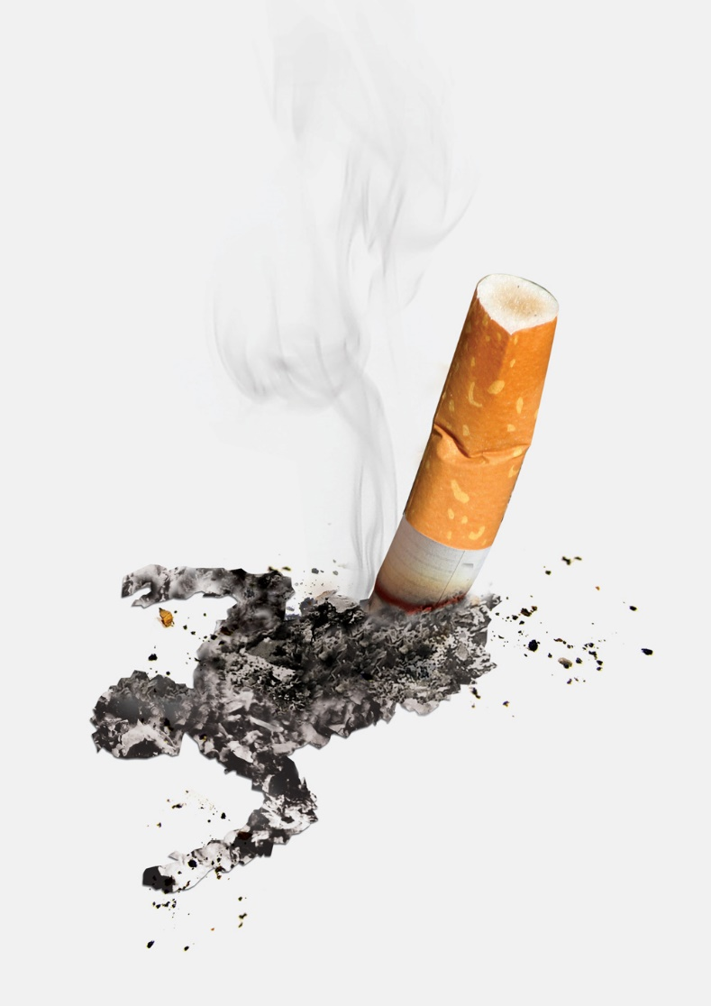
In New York City, about 12,000 people die every year due to smoking related illnesses.
在紐約市，每年大約 12,000 人因吸煙而死亡。
Source: Public Health Solutions NYC Smoke-Free

Slide 11
Cancer is the #1 cause of death among Chinese in NYC and Lung Cancer is the #1 cause of cancer deaths for Chinese in NYC.
在紐約，癌症是華人排名第一的死因。而在這其中，肺癌的發生率在華人癌症患者中排名第一。
Source: NYC Health Epi Date Brief June 2017, No. 91

Slide 12
The smoking rate for Asian American men:
In New York City, it was 25.4% in 2015 – the highest rate for all major race and ethnic groups in NYC!
亞裔男子吸煙率:
紐約市在 2015 年為 25.4% – 為紐約市所有主要種族和
族裔群體中的最高吸煙率。
Source: NYCDOHMH Commissioner Dr. Mary T. Bassett, Epi Data Brief (June 28, 2017)

Slide 13
Lung cancer deaths…
Increased 70% among Chinese New Yorkers from 2000 to 2014 while decreasing 16.4% in NYC during the same period.
肺癌死亡…
2000 年至 2014 年期間，雖然紐約市的肺癌死亡人數下降16.4%，但同期紐約市華裔的肺癌死亡人數則增加七成。
Source: NYCDOHMH Commissioner Dr. Mary T. Bassett, Epi Data Brief (June 28, 2017)

Slide 14
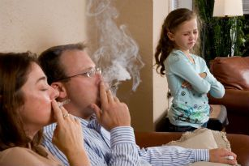
Smoking kills people around you! 吸煙害死你周圍的人！
There are 8 million tobacco-related deaths each year in the world where 1.2 million deaths are of non-smokers involuntarily exposed to secondhand smoke.
全球每年有800萬人與煙草有關而死亡。
其中120萬非吸煙者死於吸入二手煙。
Source: World Health Organization

Slide 15
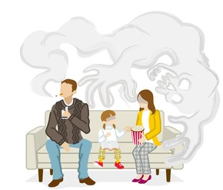
Smoking kills people around you! 吸煙害死你周圍的人！
There are 480,000 tobacco-related deaths each year in the United States . 41,000 deaths are of non-smokers involuntarily exposed to secondhand smoke.
在美國，每年有48萬人與煙草有關而死亡。
其中41,000名是非吸煙者，但死於吸入二手煙。
Source: Centers for Disease Control and Prevention

Slide 16
Smoking kills people around you! 吸煙害死你周圍的人！
In NYC, more than 200,000 children are still exposed to secondhand smoke at home.
在紐約市，仍有超過20萬兒童在家中接觸二手煙。
Source: NYC Smoke-Free

Slide 17
What is Secondhand Smoke? 什麼是二手煙?
Secondhand smoke is a mix of the smoke from a cigarette and the smoke breathed out by a smoker.
Secondhand smoke has many harmful poisons that can cause asthma, heart disease, and cancer.
二手煙是一種混合煙霧，來自於煙草燃燒產生的煙霧和吸煙者呼出的煙霧。
二手煙含有多種有害有毒物質，這些物質可以導致很多疾病的產生，比如說哮喘，心臟病和癌症。
Source: Centers for Disease Control and Prevention

Slide 18
Dangers of Secondhand Smoke 二手煙的危險
Source: Centers for Disease Control and Prevention

Slide 19
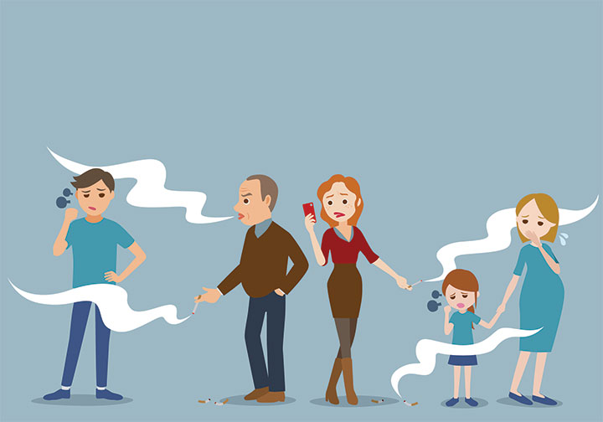
Dangers of Secondhand Smoke 二手煙的危險
A non-smoker can still get serious health problems from being around smoke.
Secondhand smoke causes approximately 34,000 early deaths from Coronary Heart Disease, 8,000 from stroke, and 73,000 from lung cancer each year.
儘管一個人從未吸過煙，但是如果長期遭受二手煙，這種煙霧仍然會對其身體健康帶來嚴重危險。
二手煙每年導致大約34,000人死於冠心病，8000人死於中風，73,000人死於肺癌。
Source: Centers for Disease Control and Prevention

Slide 20
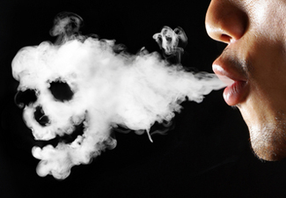
Dangers of Secondhand Smoke 二手煙的危險
Even briefly breathing secondhand smoke can damage the lining of blood vessels and cause your blood to become stickier. These changes can cause a deadly heart attack or stroke.
即使是短暫地吸入二手煙，也會損壞血管內壁，並導致你的血液變得更黏稠，這些變化可能引發致命的心臟病發作或中風。
Source: Centers for Disease Control and Prevention

Slide 21
Secondhand smoke especially harms children 二手煙尤其危害兒童
Children’s bodies are still growing, so the smoke can hurt their heart and lungs as they develop.
在發育時期的兒童, 煙霧會傷害
他們的內臟。
Protect your children from secondhand smoke! 保護你的孩子免受二手煙!
Source: Centers for Disease Control and Prevention

Slide 22
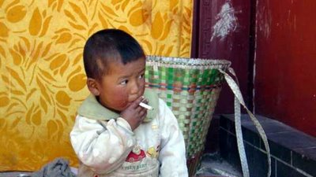
Secondhand Smoke is almost as bad as letting your child smoke! 吸二手煙的害處近乎讓你的孩子直接吸煙相同!

Slide 23
Being around secondhand smoke makes it more likely for children to get:
身處二手煙環境的兒童容易患以下的疾病：
Lung and breathing issues
Sudden Infant Death Syndrome (SIDS)
Ear infections
Asthma
肺和呼吸問題（特別是 6 歲以下的兒童）
嬰兒猝死綜合症
耳部感染
哮喘（二手煙會惡化）
Source: Centers for Disease Control and Prevention

Slide 24
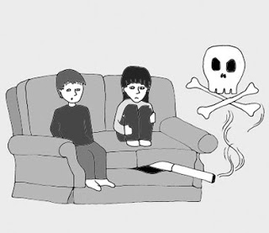
Prevent Third-hand Smoke Too 亦要防止三手煙
Third-hand smoke: Cigarette smoke and its chemicals will stick around even after you stop smoking.
It stays in your hair, skin, clothes, carpet, walls, and furniture for months or longer.
Cannot be removed by airing out a room or even cleaning.
Children and adults can be put at risk for health problems just by breathing near or touching surfaces with third-hand smoke.
三手煙: 在你停止吸煙後，香煙的煙霧和其中的化學物質仍然會長久無法散去。
吸煙所產生的煙霧和化學物質會附著你的頭髮，皮膚，衣服，地氈，家具甚至牆壁上。
其吸附效應會長達數月甚至更久，即使你停止吸煙或讓空氣散出甚至清掃都是無法根除的。
成人或者兒童會因為吸入三手煙所產生的化學物質而對身體產生影響，進而威脅到健康。
Source: Mayo Clinic

Slide 25
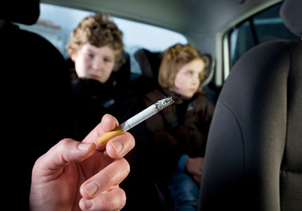
Prevent Third-hand Smoke, Too 亦要防止三手煙
To further protect your children from cigarette smoke:
Choose not to smoke in your home or car.
Take a shower or change your clothes before touching or going near your children.
保護您的孩子免受吸煙：
選擇不要在家裏或汽車內吸煙。
在接觸或靠近你的孩子之前要洗澡或換衣服。
Source: Centers for Disease Control and Prevention

Slide 26
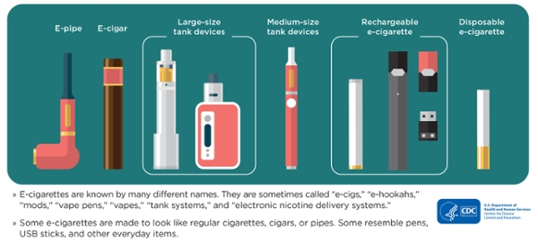
What are E-Cigarettes?
E-cigarettes come in many shapes and sizes and are known by many different names. Most have a battery, a heating element, and a place to hold a liquid.
E-cigarettes produce an aerosol by heating a liquid that usually contains nicotine, flavorings, and other chemicals that help to make the aerosol. Users inhale this aerosol into their lungs.
電子煙有多種形狀和大小，並以許多不同的名稱而聞名，大多數都有電池，加熱器和一個盛放液體的地方。
電子煙通過加熱尼古丁,調味劑,和其他有助於製造氣霧劑的化學物質的液體來產生氣霧，使用者將這氣霧劑吸入肺部。
Source: Centers for Disease Control and Prevention

Slide 27
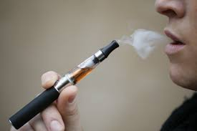
Can smoking e-cigarettes harm you? 吸電子煙會傷害你嗎？
The nicotine in e-cigarettes and regular cigarettes is addictive. Besides nicotine, e-cigarettes can contain harmful and potentially harmful ingredients, including: ultrafine particles that can be inhaled deep into the lungs. flavorants such as diacetyl, a chemical linked to serious lung disease.
電子香煙和普通香煙中的尼古丁會讓人上癮。 除尼古丁外，電子香煙還含有有害和潛在有害成分，包括:可深入肺部的有害細顆粒。 所以電子香煙同樣危害身體健康。
Source: Centers for Disease Control and Prevention

Slide 28
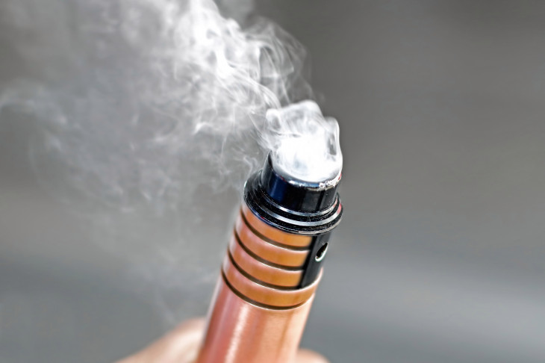
Can smoking e-cigarettes harm you? 吸電子煙會傷害你嗎？
As of February 18, 2020, a total of 2,807 hospitalized EVALI cases or deaths have been reported to CDC from all 50 states, the District of Columbia, and two U.S. territories (Puerto Rico and U.S. Virgin Islands).
截至2020年2月18日，美國50個州，哥倫比亞特區和兩個美國領土（波多黎各和美屬維爾京群島）共同向美國疾病控制及預防中心 (CDC) 報告了2,807宗有關電子煙相關的肺部損傷住院或死亡病例。
Source: Centers for Disease Control and Prevention

Slide 29
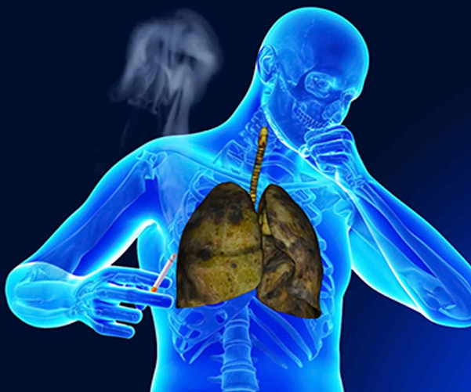
Can smoking e-cigarettes harm you? 吸電子煙會傷害你嗎？
Using E-Cigarette products is associated with severe pulmonary disease.
使用電子香煙相關的產品會導致肺部嚴重疾病
Source: Centers for Disease Control and Prevention

Slide 30
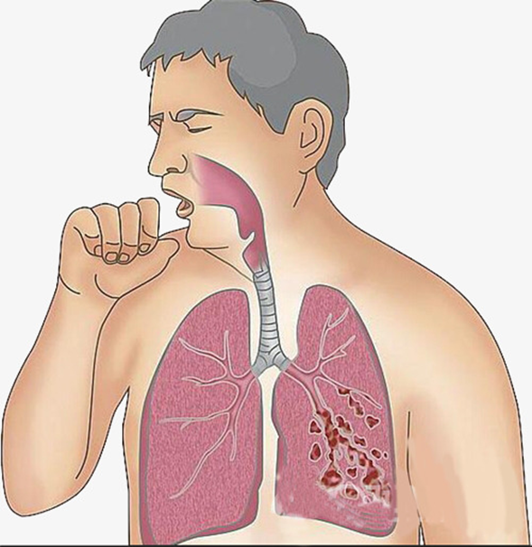
Can smoking e-cigarettes harm you? 吸電子煙會傷害你嗎？
Symptoms include :
Cough, Shortness of Breath
Chest Pain
Nausea, Vomiting, Diarrhea
Fatigue, Fever, Weight Loss
Symptoms can develop within a few days or several weeks after
症狀包括：
咳嗽，呼吸急促
胸痛
噁心，嘔吐，腹瀉
疲勞，發燒，體重減輕
症狀在幾天到幾週內發展
Source: Centers for Disease Control and Prevention

Slide 31
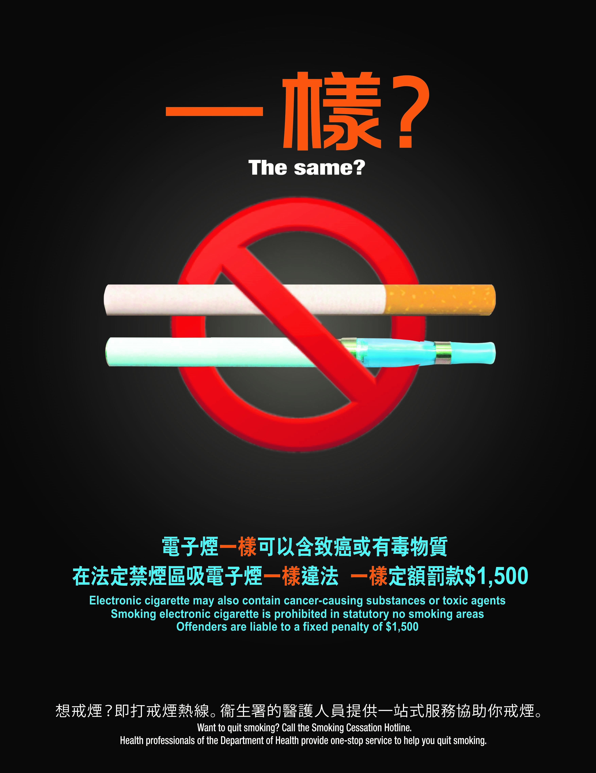
CDC warns to stop vaping!
疾病控制及預防中心
警告說要停止吸電子煙！

Slide 32
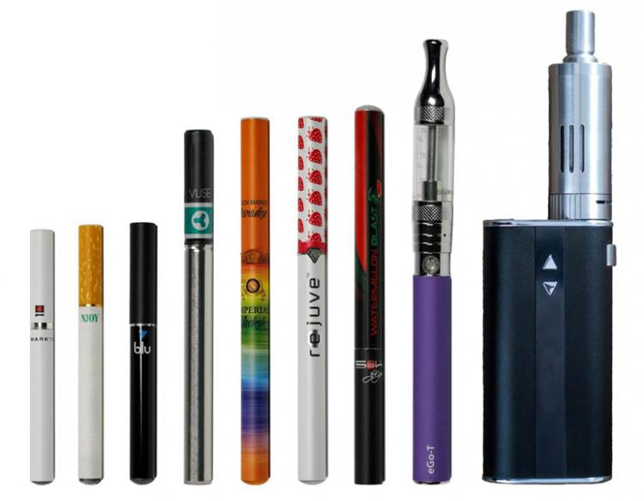
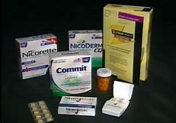
If you smoke cigarettes
and want to quit, the
Health Department
recommends using FDA-
approved medications,
which can double your
chances of success.
E-cigarettes and vaping products are
not approved by
the FDA to help
people quit smoking.
電子香煙未經食品
及藥物管理局
(FDA) 批准可幫助
人們戒煙。
如果您吸煙並想戒煙，衛生部門建議 使用經食品及藥物管理局 (FDA) 批准的藥物，這可以使您獲得成功的機會增加一倍。
Source: Food and Drug Administration

Slide 33
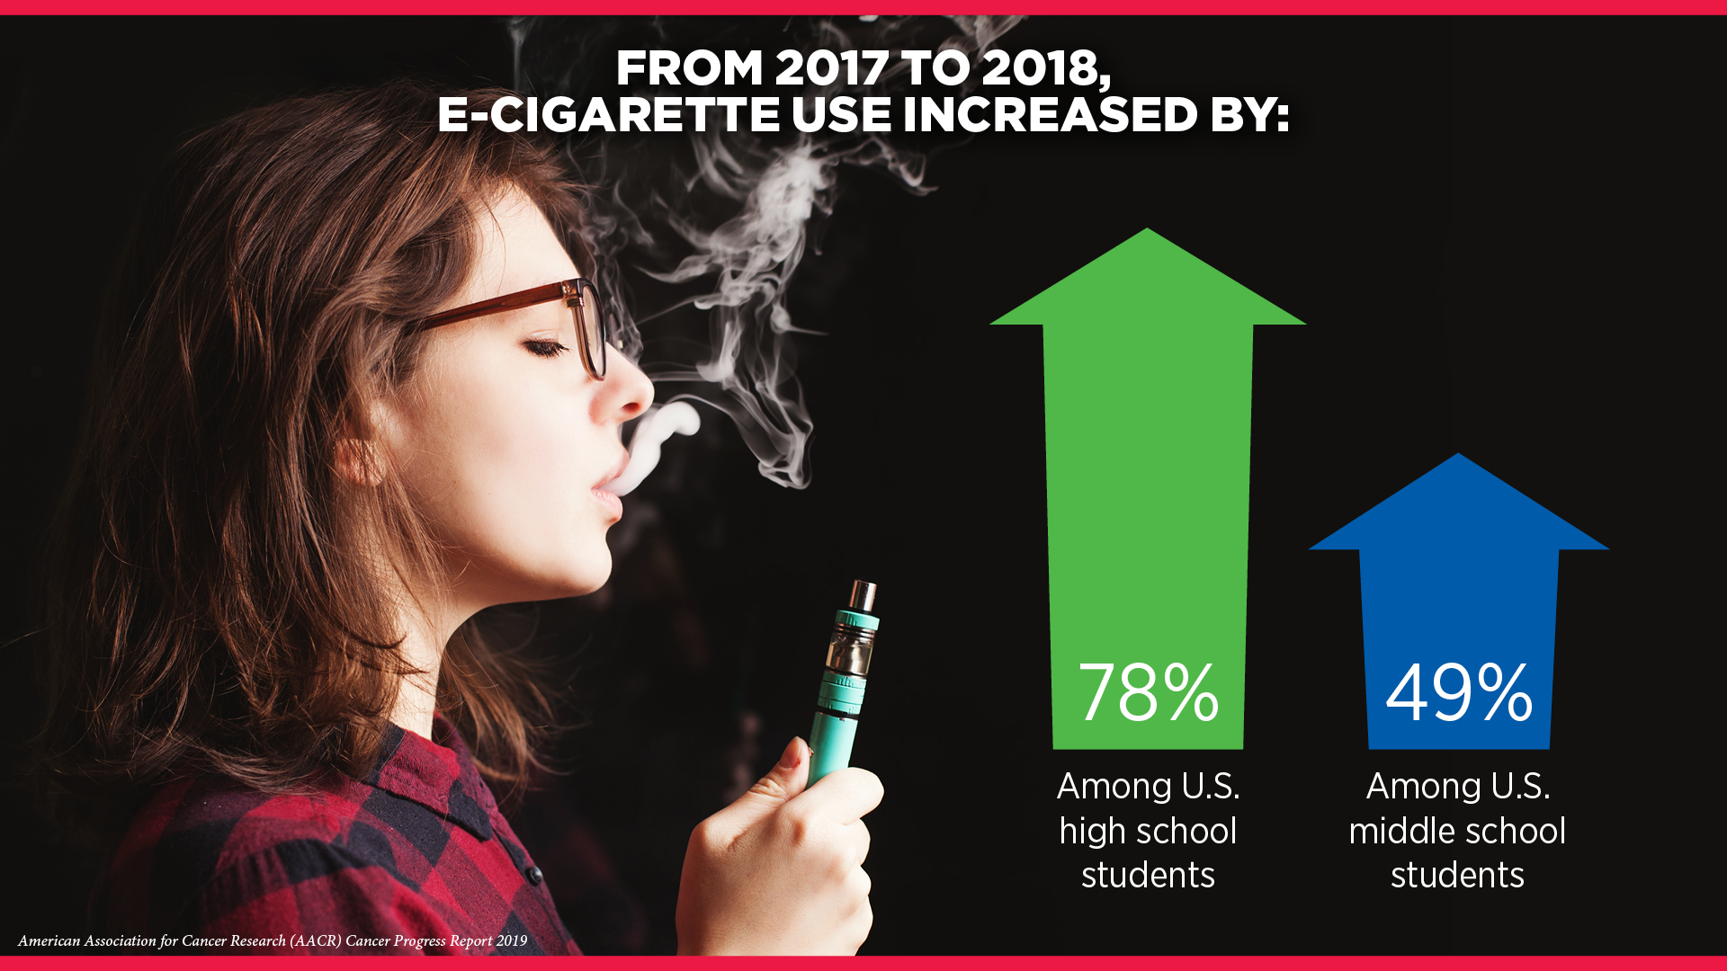
E-cigarette Use Among NYC Middle School Students 紐約市初中學生使用電子煙的情况
In 2018, 1 in 15 public middle school students (about 13,000 students, or 6.7%) reported currently using e-cigarettes. *defined as having used an e-cigarette in the previous 30 days.
2018年，在15名公立初中學生中有1名（約13,000名學生，或6.7％）目前正在使用電子煙。
*定義為在過去30天內使用過電子煙。
Current e-cigarette use was higher among older students: 9% in 7th grade and 8.4% in 8th grade, compared to 2.6% in 6th grade.
目前電子煙的使用率在年長學生中較高：7年級為9％，8年級為8.4％，而6年級為2.6％。
Source: NYC Department of Health and Mental Hygiene

Slide 34
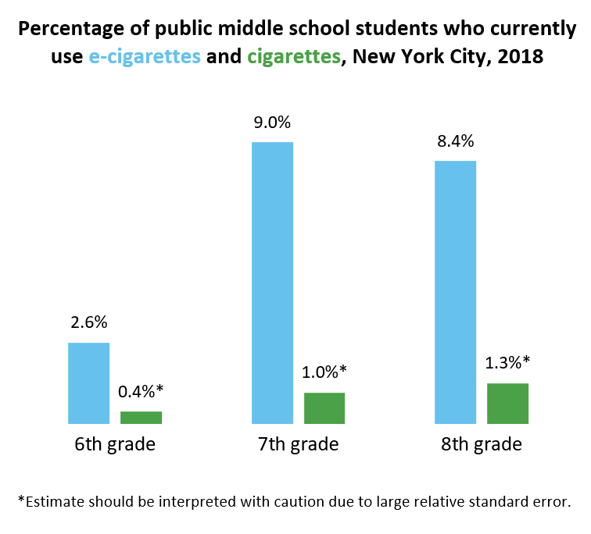
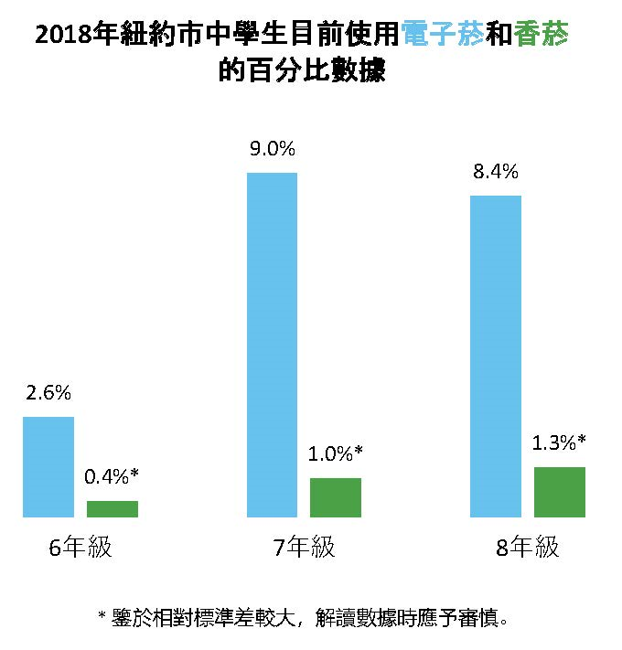
Health Department Sounds the Alarm on E-cigarette Use Among NYC Middle School Students 衛生部門對紐約市初中學生電子煙使用情況發出警報
Source: NYC Department of Health and Mental Hygiene

Slide 35
E-cigarette Use Among NYC Middle School Students 紐約市初中學生使用電子煙的情况
E-cigarette use was also much more common than cigarette use among middle school students. 在初中學生群體中吸食電子煙比吸香煙更常見。
Youth who use e-cigarettes are more likely to later try cigarettes. 使用電子香煙的青少年更有可能在以後嘗試香煙。
In New York City, e-cigarette use is much more common among youth than adults. 在紐約市，青少年吸食電子煙比成年人更普遍。
Source: NYC Department of Health and Mental Hygiene

Slide 36
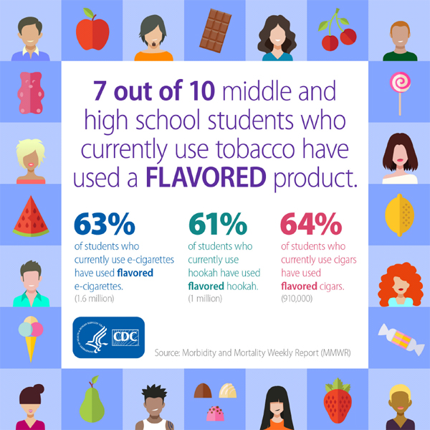
E-cigarette Use Among NYC Middle School Students 紐約市初中學生使用電子煙的情况
E-Cigarette flavors are a major reason for use among youth in the US. Kid-friendly flavors such as cotton candy, strawberry and mint make e-cigarette seem fun and harmless.
Big Tobacco companies have been selling e-cigarette and vaping products for years with kid friendly flavors such as cotton candy, strawberry, and mint and designs to make them seem fun and harmless to kids. Research done by the NYC Health Department has found that Big Tobacco's efforts have worked.
電子煙的味道是吸引美國年輕人使用的主要原因。棉花糖，草莓和薄荷等適合兒童的口味使電子煙看似更有趣及無害。
多年來，大型煙草公司一直在銷售適合兒童口味的電子煙和電子煙產品如棉花糖，草莓和薄荷。其設計使孩子感覺有趣又無害。紐約市衛生局研究發現大型煙草公司的策略成功了。
Source: NYC Department of Health and Mental Hygiene

Slide 37
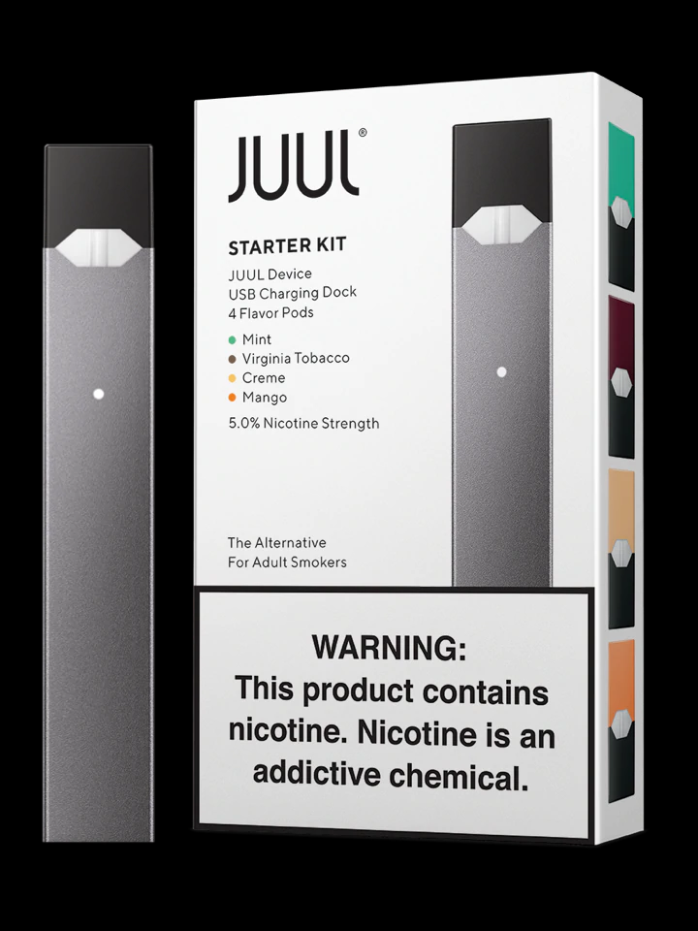
How Does E-cigarettes Use and Nicotine Harm Youth? 使用電子香煙和尼古丁如何危害青少年？
One pod of a popular e-cigarette, JUUL, can contain as much nicotine as a whole pack of cigarettes.
一個流行的電子煙的容量(pod)，JUUL，可以包含與整包香煙一樣多的尼古丁。
Nicotine can change the chemistry of the teen brain.
尼古丁可以令青少年大腦組織產生化學變化。
Nicotine can worsen memory and concentration, decreasing learning ability.
尼古丁會使記憶力和注意力惡化，降低學習能力。
Source: NYC Department of Health and Mental Hygiene

Slide 38
How Does E-cigarettes Use and Nicotine Harm Youth? 使用電子香煙和尼古丁如何危害青少年？
Along with nicotine, the aerosol from heated e-liquids can also contain harmful chemicals like formaldehyde (cancer-causing chemical), benzene (cancer-causing chemical), diacetyl from flavoring (linked to lung disease), and heavy metals (such as nickel, tin, and lead).
除了尼古丁，來自加熱的電子液體的氣霧劑也可能含有有害化學物質，如甲醛（致癌化學物質），苯（致癌化學物質），調味品中的雙乙酰（與肺病有關）和重金屬（如鎳，錫和鉛）
Bystanders can also breathe in these chemicals.
旁人還可以通過空氣吸入這些化學物質。
Source: NYC Department of Health and Mental Hygiene

Slide 39
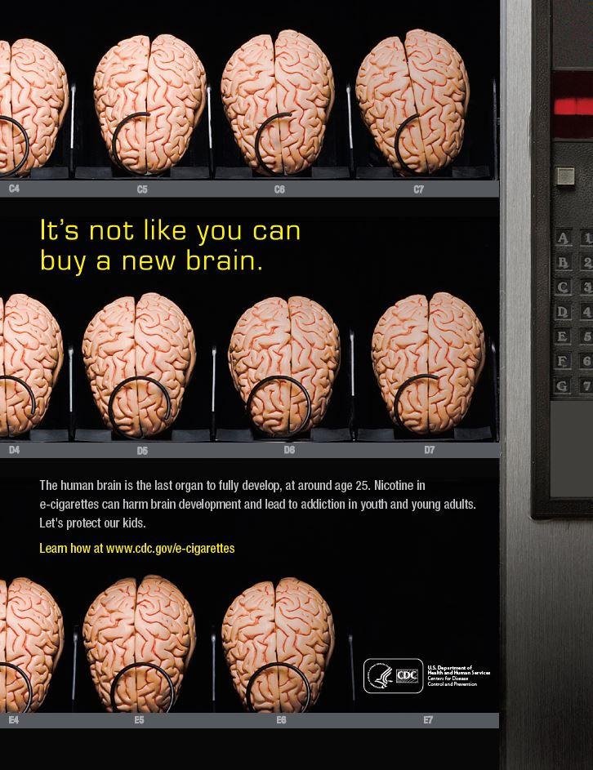
受損的腦部
不能重新購買

Slide 40
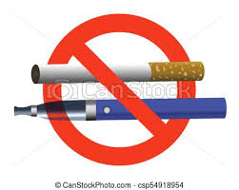
Ban on the Sale of Flavored E-Cigarettes 禁止銷售加味電子煙
Since July 2020 the sale of flavored e-cigarettes is prohibited in New York.
Stores selling tobacco, e-cigarettes & vaping products to anyone under 21 will face criminal and civil penalties.
自2020年7月起，紐約禁止銷售加味電子煙。
向21歲以下任何人銷售菸草,電子煙和電子煙產品，該商店將面臨刑事和民事處罰 。

Slide 41
Why is smoking bad for you?
為什麼吸煙
有害健康？

Slide 42
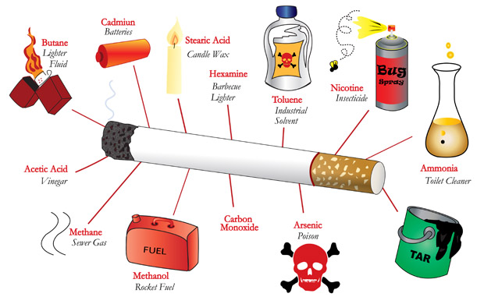
Over 7,000 toxic CHEMICALS - 70 are known to cause cancer!!! 在超過 7,000 種的毒性化合物內有 70 種能導致癌症!!!
Source: Food and Drug Administration

Slide 43
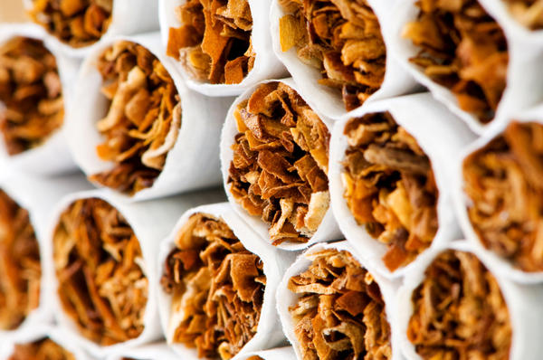
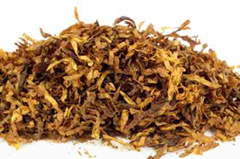
Nicotine 尼古丁
Highly addictive
高度上瘾
Acts on brain within 15 seconds
在 15 秒內就能影響大腦
Affects mood and behavior
影響情緒和行為

Slide 44
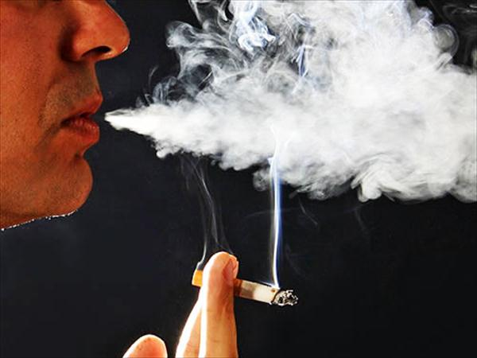
Carbon Monoxide 一氧化碳
Poisonous gas absorbed into blood
毒氣體會溶入血液
Reduces muscle and heart functions
減少肌肉和心臟功能
Causes fatigue, weakness, and dizziness
會導致疲勞，虚弱，和暈眩

Slide 45
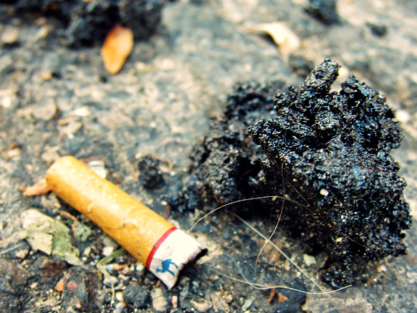
Tar 煙焦油
Has chemicals that can cause cancer
有化合物能導致癌症
70% remains in lungs
70％ 被困在肺部

Slide 46
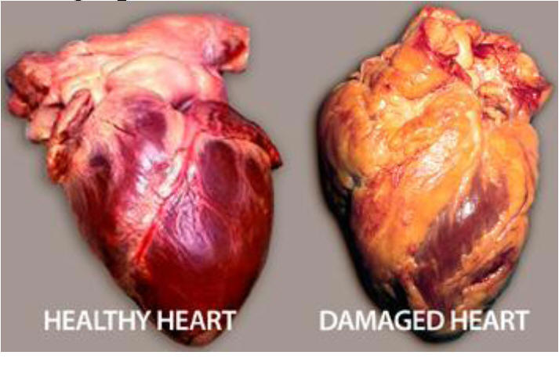
Heart Disease 心臟病
Smoking Causes:
吸煙能導致
Atherosclerosis → blocks blood flow
動脈粥樣硬化 → 阻止血液流動
Raises blood pressure and blood clots
提高血壓和引起血凝塊
Source: Centers for Disease Control and Prevention

Slide 47
Smoking Causes:
吸煙能導致
Heart Disease 心臟病
Smokers are two times more likely to develop heart disease than non-smokers.
與非吸煙者相比，吸煙者發生心臟病的可能性高出兩倍。
Other heart diseases: 其它心臟病
Peripheral artery disease 外周動脈疾病
Abdominal aortic aneurysm 腹主動脈瘤
Source: Centers for Disease Control and Prevention

Slide 48
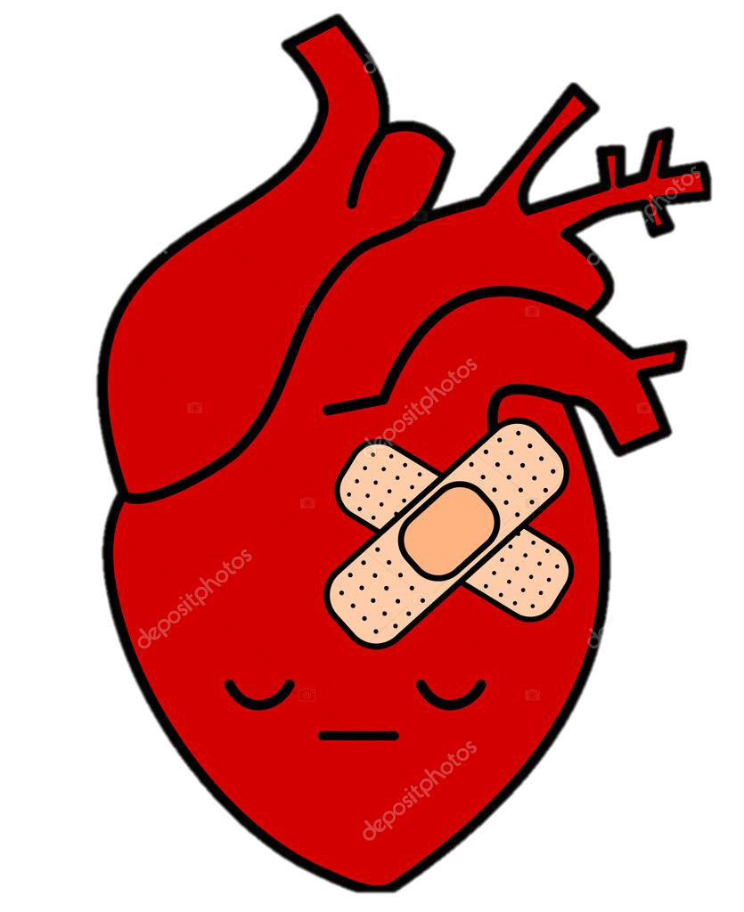
Smoking is a major cause of Heart Disease and causes one out of every four deaths. 吸煙是心臟病的主要原因，導致每四分之一的病例死亡。
Source: Centers for Disease Control and Prevention
Notes:
Source Center for Disease Control and Prevention https://www.cdc.gov/tobacco/campaign/tips/diseases/heart-disease-stroke.html

Slide 49
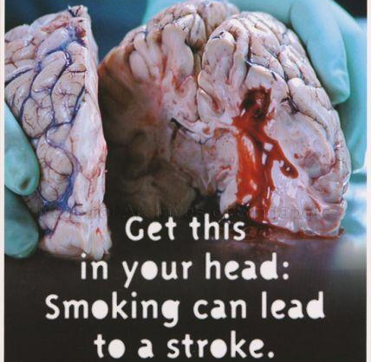
Stroke 中風
Smoking Causes:
吸煙能導致
Men who smoke more than a pack of cigarettes a day are also at greatly increased risk of stroke.
每天吸煙超過一包的男性也大大增加了中風的風險。
Source: Centers for Disease Control and Prevention

Slide 50
Smoking Causes:
吸煙能導致
Stroke 中風
Smoking makes blood sticky and clots are more likely to form. It also increase plaque build up in your arteries. Under these conditions a stroke is more likely to occur.
吸煙會使血液粘稠度增高，促使血液中形成血液凝塊。吸煙能導致動脈斑塊在頸動脈的積累。在這情況下，更容易發生中風。
Source: Centers for Disease Control and Prevention

Slide 51
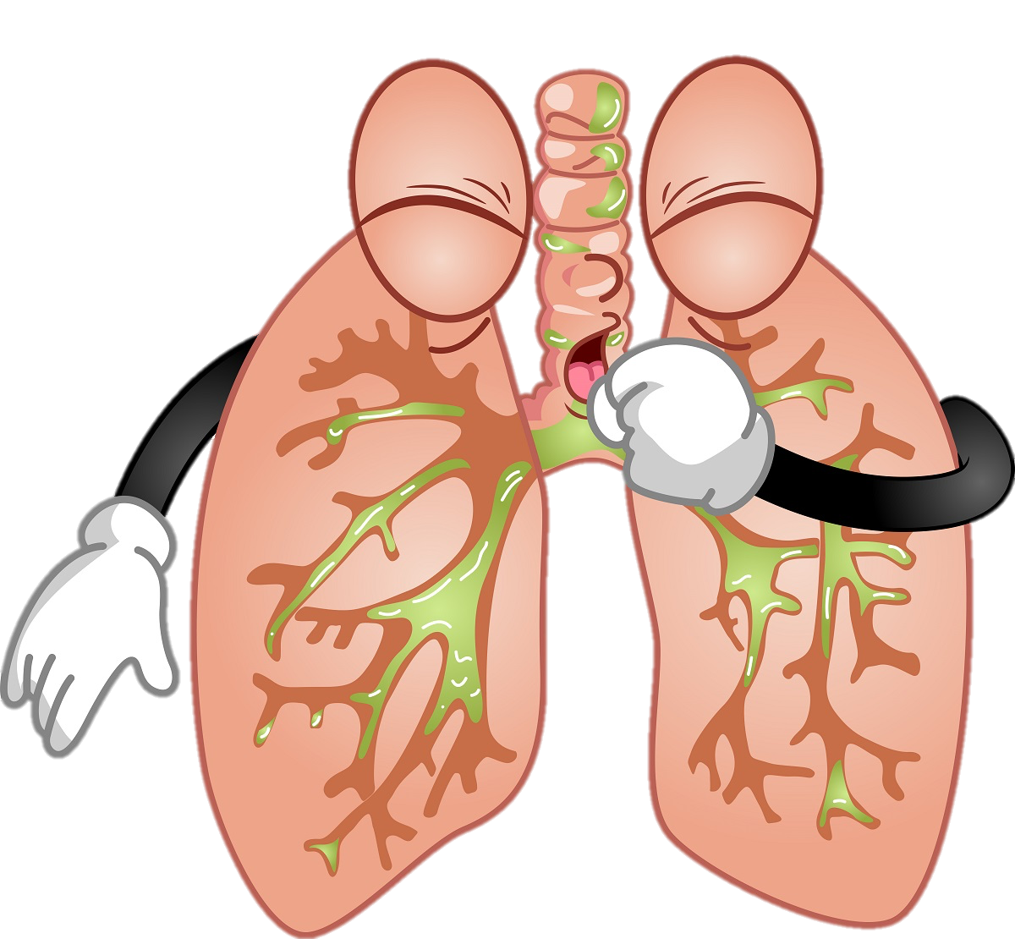
Smoking Causes:
吸煙能導致
Lung and Breathing issues: (肺和呼吸問題)
Asthma (哮喘)
Chronic Obstructive Pulmonary
Disease (慢性阻塞性肺病)
Chronic Bronchitis (慢性支氣管炎)
Emphysema (肺氣腫)
Source: Centers for Disease Control and Prevention

Slide 52
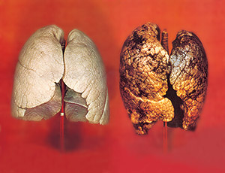
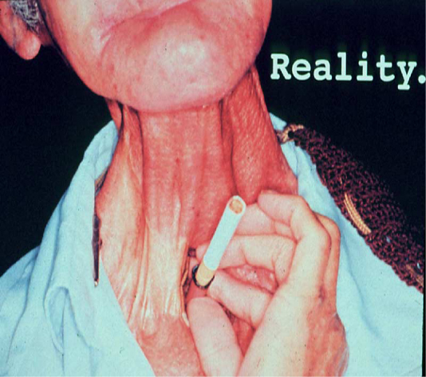
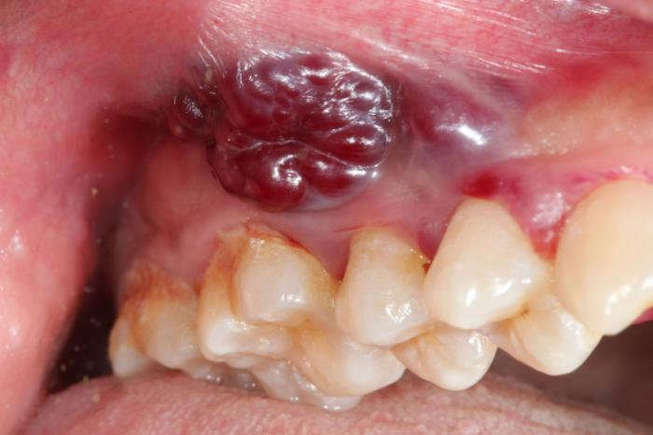
Cancer 癌症
Smoking
Causes:
吸煙能導致
Lung cancer
肺癌
Throat cancer
咽喉癌
Mouth cancer
口腔癌
Source: Centers for Disease Control and Prevention

Slide 53
Cancer 癌症
Smoking
Causes:
吸煙能導致
Esophagus 食管
Bronchus 支氣管
Stomach 腸胃
Kidney 腎
Colon 結腸
Pelvis 盆腔
Rectum 直腸
Urinary bladder 膀胱
Liver 肝
Cervix 子宮頸
Pancreas 胰腺
Acute myeloid leukemia
急性骨髓性白血病
Voice box (Larynx) 喉
Trachea 氣管
Source: Centers for Disease Control and Prevention

Slide 54
Lung Cancer Screening with Low-Dose Computed Tomography (LDCT) 肺癌篩查使用低劑量 CT
During an LDCT scan, you lie on a table and an x-ray machine uses a low-dose of radiation to make detailed images of your lungs. It only takes a few minutes and is not painful.
進行 LDCT 掃描的時候，人需要躺在檢測台上，一台儀器會發出低劑量的 X 射線，來拍攝肺部的圖像。這個過程是無痛的，並且只需要幾分鐘的時間。
It is currently the only recommended screening strategy for lung cancer.
是目前唯一推薦的肺癌篩查的方法。
*** Best way to lower chances of dying from lung cancer is to stop smoking. ***
*** 降低肺癌死亡幾率的最好辦法是戒煙。 ***
Source: Centers for Disease Control and Prevention

Slide 55
Who should be screened? 誰應該檢查?
The United States Preventive Services Task Force (USPSTF) recommends lung cancer screening for individuals who:
Are 50 to 80 years old
No signs or symptoms of lung cancer
No history of lung cancer
Currently smoke or quit less than 15 years ago
Are or were considered heavy smokers (20 pack-years history)
美國預防服務工作組 (USPSTF) 建議以下人士進行肺癌篩查:
50 至 80 歲
沒有肺癌的症狀
沒有肺癌史
目前吸煙或戒煙不到15年
被認為是重吸煙者（ 二十包-年吸煙史）
Source: U.S. Preventative Services Task Force 03/09/2021

Slide 56
Eligibility for lung cancer screening 肺癌篩查的資格
Talk with your health care professional to decide whether screening is right for you.
請經過專業醫護人員諮詢後決定篩查是否適合您。
Most private insurance plans cover lung cancer screening for people age 55 to 80, without pocket expenses.
多數的私人保險都可以提供肺癌篩查的全部費用給 55 至 80 歲
之間的人群。
Source: Agency for Healthcare Research and Quality

Slide 57
Eligibility for lung cancer screening 肺癌篩查的資格
Medicare pays for lung cancer screening with no out-of-pocket costs for people
age 55 to 77
who don’t have symptoms of lung cancer
who currently smoke or quit smoking in the last 15 years
have a smoking history of at least 30”pack years”
have a written order from your doctor
紅藍卡 醫療保險可以提供肺癌篩查的全部費用給
55 至 77 歲
沒有肺癌的症狀
目前吸煙或在過去 15 年內戒煙的人
有至少三十包“ 包年”吸煙史
有醫生的書面處方
Source: Medicare.gov

Slide 58
伍慧明
戒菸輔導員
王嘉廉社區醫療中心

Slide 59
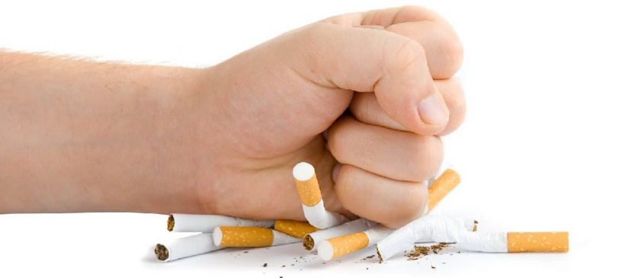
Reasons To Quit Smoking
戒煙原因

Slide 60
Quitting: Save Money 戒煙: 省錢
Number of Cigarettes Per Day 一天抽多少支煙 10
Cigarette Cost per Pack 一包煙的價錢 $13.00
In 6 Months 6 個月內 你可以節省 $1,179
In 1 Year 1 年內你可以節省 $2,408
In 5 Years 5 年內你可以節省 $12,807
In 10 Years 10 年內你可以節省 $27,689
Think about all the money you save from quitting. $$$
想一想你戒煙後所能省下的錢。$$$
½ pack a day smoker spending $13-$15 per pack*
一天半包
吸煙者一包煙花 $13-$15*
*Based on cigarette prices in NYC
基於紐約市的香煙價格
Calculator: https://www.nysmokefree.com/ToolsAndResources/SavingsCalculator
Notes:
NOTE: The price of cigarettes in this slide is based on NY prices. Please adjust the numbers based on your locality.

Slide 61
Quitting: Health Benefits 戒煙: 健康好處
Short-Term Benefits 短期好處 Blood circulation improves 血液循環改善 Walking becomes easier 行走變得容易 Less coughing, fatigue, and shortness of breath 少咳嗽，疲勞，氣促 Decreased risk of coronary heart disease (CHD) 降低冠心病風險 | Long-Term Benefits 長期好處 Decreased risk of cancer of lung, mouth, throat, esophagus, bladder, kidney, and pancreas 降低肺，口腔，咽喉，食管，膀胱，腎臟和胰腺癌的風險 Decreased risk of stroke 降低中風風險 Reduced lung cancer death rate 降低肺癌死亡率
Source: American Cancer Society

Slide 62
Smokers die 10 years earlier than non-smokers.
吸煙者比非吸煙者提早死亡10年。
Source: Centers for Disease Control and Prevention

Slide 63
It’s Never Too Late To Quit 戒煙永遠不會太遲
Age of Quitting Smoking 戒煙的年齡 | Benefits in Comparison with Those Who Continued 戒煙者與繼續吸煙者相比之益處
At about age 30 大約 30 歲 | Gain almost 10 years of life expectancy 增益 10 年的壽命
At about age 40 大約 40 歲 | Gain 9 years of life expectancy 增益 9 年的壽命
At about age 50 大約 50 歲 | Gain 6 years of life expectancy 增益 6 年的壽命
At about age 60 大約 60 歲 | Gain 3 years of life expectancy 增益 3 年的壽命
After the onset of life-threatening disease 在有威脅生命的疾病發作後 | Rapid benefit, people who quit smoking after having a heart attack reduce their chances of having another heart attack by 50%. 患上心肌梗塞之人仕，在戒煙後能降低 50% 復發機會。
Source: World Health Organization

Slide 64
Quitting: For Your Family 戒煙: 為你的家人
Be with your family longer!
你們與家人生活更長時間！
Protect Your Loved Ones 保護你關愛的人
By going smoke-free, you could improve the well-being of both you and your loved ones!
戒煙後，你可以改善你及親人的健康，增進幸福。

Slide 65
Tips To Quit Smoking 戒煙的要訣
Make a plan: keep your hands busy and mind off cigarettes.
制定計劃： 保持雙手忙碌 轉移煙 癮 的注意力。
1
Make your home and car smoke-free.
把你的住所及汽車變成禁煙區。
2
Get support: talk to your family and friends about your plan to quit.
尋求支持：與親友談論你正在計劃戒煙，讓他們知道可以怎麼樣幫助你。
3
Use a quitting aid: nicotine patches and gum.
選用 戒煙尼古丁代替品： 膠貼及口香膠。
4
Call (800) 838-8917: a trained advisor who CAN OFFER SUPPORT.
致電戒煙專線 (800) 838-8917： 受過專業訓練的顧問會幫助你做一個適合你個人的戒煙計劃。
5

Slide 66
紀承佑
戒煙顧問
亞洲人平等會

Slide 67
Reasons for Using Nicotine Replacement Therapy (NRT) 用尼古丁替代療法 (NRT) 的原因
Using NRT can double your chances of quitting successfully. 使用尼古丁替代療法可使你戒煙的成功率增加一倍。
It can help the person quit more comfortably. 能使戒煙的人更舒服。
NRT treats nicotine withdrawal symptoms, by just providing doses of nicotine without the other 7000+ chemicals associated with smoking cigarettes. 尼古丁替代療法只提供一定劑量的尼古丁，來治療尼右丁戒斷症狀。
而不會提供其他7000多宗與吸煙有關的化學物質。
Source: Centers for Disease Control and Prevention

Slide 68
Dispelling Myths about Nicotine Replacement Therapy (NRT) 尼古丁替代療法的誤解
Nicotine and NRT do not cause cancer. 尼古丁和尼古丁替代療法不會導致癌症。
Nicotine does not cause tobacco smoking related diseases. It is the other chemicals and toxins found in cigarettes that cause negative health effects. 尼古丁不會導致與煙草有關的疾病； 對健康造成負面影響是香煙中的毒素而不是尼古丁。
Using NRT does not increase the risk of heart attacks. It can be used safely by people with diabetes or high blood pressure. 尼古丁替代療法不會增加心臟病發作的風險,糖尿病或高血壓患者也能安全使用者療法。
NRT does not cause weight gain. 尼古丁替代療法不會增加體重。
Source: National Cancer Institute

Slide 69
Quitting Is Possible! Start Today! 戒煙從今天開始!

Slide 70
Resources For Smokers 給吸煙者的幫助與支持
NYCDOHMH – NYC Quits
www.nyc.gov/nycquits
Prescription Help:
Medicaid
Big Apple

Slide 71
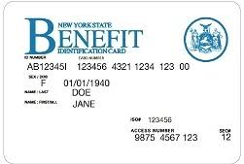
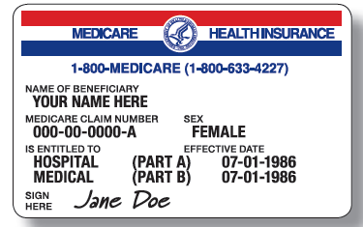
Quit Smoking 戒煙
Most health insurance plans, including Medicaid, cover treatment to help you quit smoking.
大多數健康保險計劃，包括政府醫療補助，都覆蓋幫助您戒煙的治療方案。

Slide 72
Quit Smoking Resources List by Region 戒煙資源按地區排列 USA Nationwide 全美國
Organization 機構 | Services 服務 | Hours of Operation 服務時間 | Contact Info 聯絡方式
Nationwide (U.S.) Asian Smokers’ Quitline 華語戒煙專線 | A free nationwide Asian-language phone quit smoking service. They offer self-help materials, local program referrals, one-on-one telephone counseling, and free nicotine replacement therapies sent to their home. 全國的亞洲語言戒菸熱線，我們提供自助材料、社區項目推薦、一對一電話諮詢並可將免費的 “尼古丁替代療法” 送到你家。 | Monday to Friday, 7am-9pm, Pacific Time 10am-12am, Eastern Time 星期一到五, 7am-9pm 太平洋標準時間 10am – 12am, 東岸時間 | Mandarin, Cantonese (國語, 粵語): 1-800-838-8917 Korean (韓語): 1-800-556-5564 Vietnamese (越南語): 1-800-778-8440

Slide 73
Quit Smoking Resources List by Region 戒煙資源按地區排列 New York State 紐約州
Organization 機構 | Services 服務 | Hours of Operation 服務時間 | Contact Info 聯絡方式
New York Smokers’ Quitline 紐約州吸煙者幫助熱線 | One-to-one counseling with help developing individualized quit plan. Free nicotine replacement therapy if eligible. 一對一的諮詢服務幫助您制定戒菸計劃。符合條件者，我們將提供免費的 “尼古丁替代療法”。 |  | Website (網站): www.nysmokefree.com English (英語): 1-866-697-8487

Slide 74
Quit Smoking Resources List by Region 戒煙資源按地區排列 New York City 紐約市
Organization 機構 | Services 服務 | Hours of Operation 服務時間 | Contact Info 聯絡方式
New York City Asian Americans for Equality (AAFE) 亞洲人平等會 | A community-based organization that offers free individual counseling, help developing a quit plan, and free nicotine replacement therapy if eligible. 我們是一個社區性的組織，在這裡我們將提供免費的個人戒菸諮詢，制定戒菸計劃。符合條件者，我們將提供免費的 “尼古丁替代療法”。 |  | English, Mandarin, Cantonese (英語, 國語, 粵語): 1-212-979-8988
Charles B. Wang Community Health Center (CBWCHC) 王嘉廉社區醫療中心 | A community health center that offers free in person and phone counseling to patients and community members by a trained health coach and offers free nicotine patches and gum for eligible smokers. 我們是一個社區健康中心，提供免費的來訪及電話諮詢，社區成員也可接受健康訓練。同時，符合條件者，我們將為吸煙者提供免費的 “尼古丁替代療法”。 |  | English, Mandarin, Cantonese (英語, 國語, 粵語): 1-718-661-6040 http://cbwchc.org/QuitSmoking.asp

Slide 75
North American Chinatown Smoke Free Day 北美華埠戒煙日
This presentation was prepared by
Chinese American Medical Society, New York
Maggie Chen
Warren W. Chin, M.D., Executive Director
Jamie Love, Administrator
Joanna Li, Administrative Assistant
NewYork-Presbyterian Lower Manhattan Hospital
Chinese Community Partnership for Health
Esther Wang, R.N.
With Support From Charles B. Wang Community Health Center, New York
Rachelle Ocampo & Regina Lee, F. Lee, J.D.

Slide 76
Questions/ Thank you!
提問時間
謝謝參加！

